Slide 1

Data journalism for editors
MaryJo Webster CAR Editor maryjo.webster@startribune.com @MaryJoWebster

Slide 2
What is data journalism?
A story that relies heavily on our own analysis of “raw data”
A story that uses our own data analysis to provide context or more support to a story
A data-driven digital product: i.e. interactive map, graphic, database, news app, data visualization

Slide 3

Data is a source
Notes:
The #1 thing to take away from this session is that you – and your reporters – should be treating data the same way you treat human sources.

Slide 4
Same sourcing rules apply...
Is this source reliable? And how do you know that?
What can and can’t this source tell us?
Verify what this source tells you
Make sure you use more than one source
Notes:
The best thing you can do to backstop your reporter on a story involving data analysis is to ask the same questions you would when they have a new source
especially – is this source reliable? and how do you know that?

Slide 5

If you ask wrong question, you’ll get wrong answer
Notes:
When talking to humans, you might get a wrong answer if you phrase your question in a way that they don’t quite understand. Data works the same way – the difference is that you are asking your question in “computer speak”, so it’s much easier for us to trip up – since that’s not our native tongue. To get around this, it’s a really good idea to ask lots and lots of questions – framed in different ways. Luckily, data will sit and answer questions for hours and hours on end, without getting annoyed by you.

Slide 6
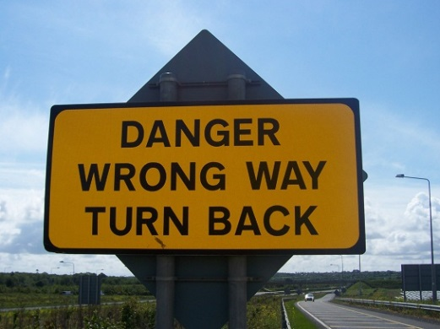
If something doesn’t seem quite right, check it out
Notes:
There are all kinds of ways your analysis results can end up with big outliers or unusual results – and the majority of the time it’s either the result of faulty data to begin with or some error in the analysis. A paper in Florida published a story saying the Llasa Appso was the most common dog breed in their county based on an analysis of dog license data. The next day they had to run a correction. The reporter had sorted the spreadsheet incorrectly.

Slide 7

Data can only tell you what it knows
Notes:
A reporter at the PiPress asked for data on foster care homes that had had their licenses suspended or revoked. She asked that the data include the reason the license was pulled. DHS kind of freaked out on us. We got their data people to have a phone conference with us and then they explained that their database doesn’t include the reason – that information only existed in their paper records. The database was essentially an index of their paper records.

Slide 8

It will often lead you to more questions…
Notes:
The analysis and reporting phase of the story should be one – with the reporter going back and forth between data and human sources. Oftentimes, the humans will lead the reporter to something in the data that they hadn’t thought to look for before.

Slide 9

But shoe-leather reporting
is as important as ever…
Data should not be your only source
Notes:
There are people who will know the topic or the particular dataset better than we do and it’s crucial that we get their feedback on our analysis. If they question our analysis, even slightly, it’s important to go back and review our work, if not re-do it altogether. A key part of your job is to make sure the reporter has consulted one or more people and shown them the results.

Slide 10
What is “data”?
Notes:
Before we get too much farther, I’d like to take some time to just talk about what I mean when I use the word “data.”

Slide 11
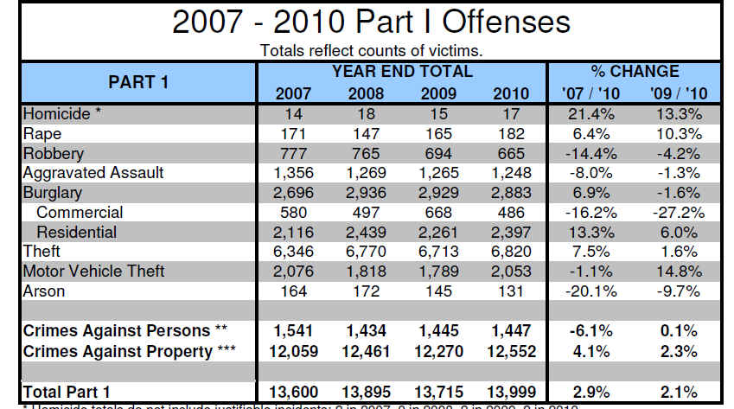
Aggregate
or
Summary
Notes:
We’re all very accustomed to data like this – a summary or aggregate. Officially, though, this is “information” that was generated from data.
Still there are times when we can only get aggregate or summary information– data from schools is one of the best examples. We can’t get records showing how each student did on their standardized tests, but we can get an aggregate for groups of students (all black students in one grade in one school, for example).

Slide 12
Questions we can ask the aggregate data?
Which crime(s) had biggest increase or decrease across the three years
Compare property crime to crimes against persons
Notes:
The questions that you can ask aggregate data will be restricted by the amount of information you’re provided.
This police data is very limited. In fact, the answers to our questions are already there – we don’t need to do any of our own analysis (although we might want to check their math)

Slide 13
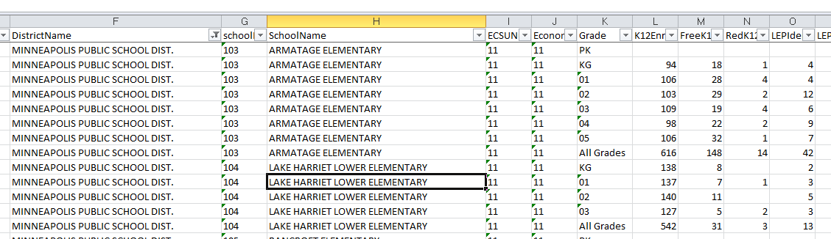
Notes:
But aggregate data that is more complex – such as this one – offers more opportunity for questions.
This is enrollment data – by “special populations” – for all schools in the state. I’ve zoomed in on some Minneapolis schools. You’ll see that there is one record for each grade, plus a record that combines all grades. Then it shows the number of students on free lunch, reduced price lunch, limited English proficiency, special education, etc. We could use this data to find which schools have the highest concentration of poor students. Or we can get multiple years of this same data and see which schools have had the greatest increase or decrease.
Or we could do this same analysis but at the district level, rather than school level.

Slide 14
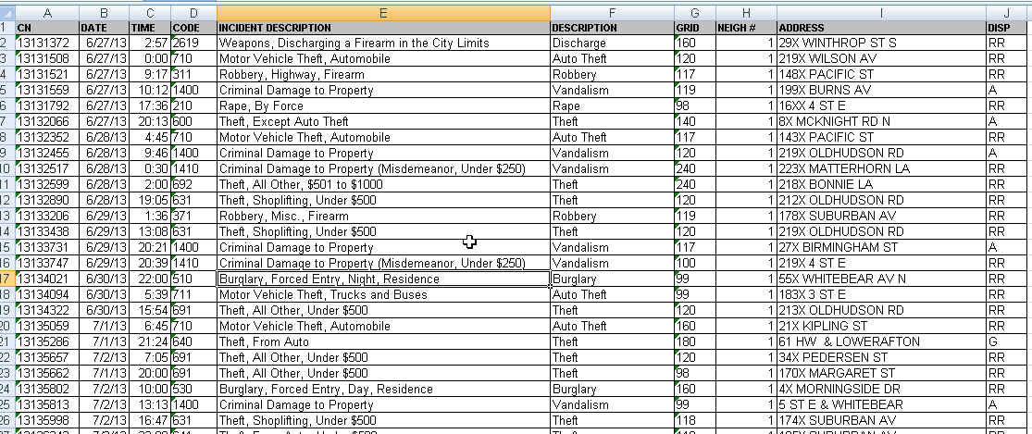
Raw data
Notes:
But in situations where we are not restricted by privacy laws, we should always try to get as detailed data as we can – this is what is called “raw data.”
Raw data is what is used to generate those summary charts, like the police UCR report one we just looked at.
This is from the St. Paul police and shows one record for each incident. It shows where it occurred by an address, the neighborhood and the police district; It has the date and time it was reported, the type of incident and whether it resulted in a report.

Slide 15
Questions for the raw data?
Which neighborhood had biggest increase in crime?
Were some parts of the city more prone to certain types of crimes than other neighborhoods?
Is there a time of day or day of week when more crimes are reported?
Per capita crime rates
You can turn this into a map!
Find crime reports at particular addresses
Notes:
So now we have lots of questions we can ask. Not only can we generate the same kind of summary report, but we can go off in other directions.
We could match this data up to another dataset that has addresses for all the schools in the city and see how often reports are taken there.
We can compare neighborhoods -- is gun violence increasing faster in one neighborhood than another?
We can look at more detail – instead of just knowing that there were 6800-ish thefts in 2010, we can see what kinds of thefts (items from cars? shoplifting? etc) and where it’s occurring most.

Slide 16
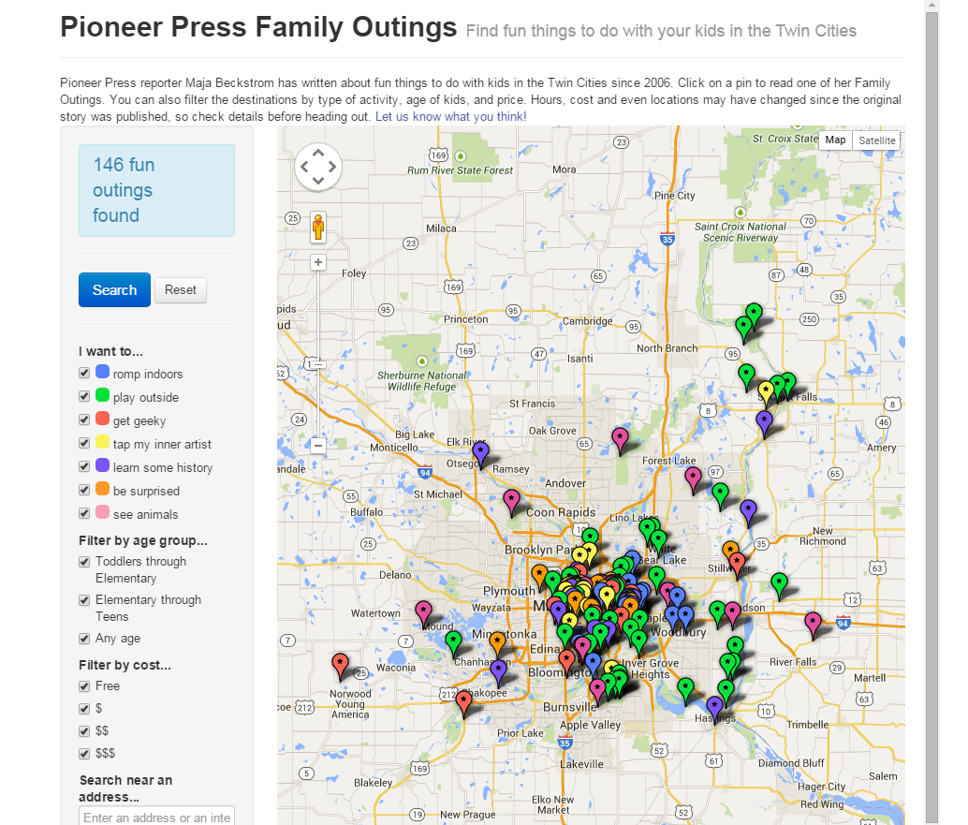
Anything can become data.....
Notes:
You can turn just about anything into data. At the Pioneer Press, we built a database of stories that the Family reporter had written and then turned it into an interactive map that parents could use to find cool things to do with their kids.

Slide 17
NY Times reporter Derek Willis – database of congressional press releases
search for “Ebola” in title
January-June, 2014 | 0
July | 2
August | 8
September | 56
October | 275
Notes:
“Data” doesn’t have to start out in rows and columns. NY Times reporter Derek Willis keeps a database of every congressional press release (he scrapes them from the Web) and then he can tap it for various things now and then. Last year as the Ebola crisis was hot news, he wondered what the press releases had to say about Ebola....and his data showed that the discussion among the Congressmen had heated up at pretty much the same pace as the news coverage.

Slide 18
Managing/Editing data journalism
A road map
Notes:
Let’s turn our attention to some more specific things you can do to foster data-driven journalism in the newsroom and support your reporters when they are doing data-driven stories.

Slide 19
Beat development
Encourage reporters to find their data “sources”, add them to their Rolodex, take them “out for coffee,” etc.
Give reporters time to explore a dataset that is crucial to his/her beat, perhaps even generate a minimum story from it

Slide 20
Ideas
Encourage reporters to frame ideas as questions, not nouns.
Before launching something, make sure reporter looks to see what other journalists, academics, non-profits have done. Learn from their work, rather than reinventing the wheel.
Data by beat
Data can benefit stories of all sizes.....

Slide 21
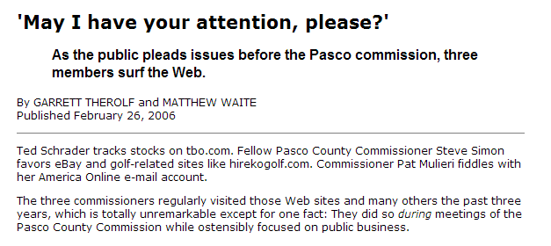

Data: Internet history for all county employees
Notes:
BE A BETTER WATCHDOG: Our job as watchdogs of government requires us to find things that government officials won’t just hand to us in a press release. And to find those things, investigative journalists have long followed the mantra of having a “documents state of mind.” Now that so much government information is stored electronically, we need to have a “data state of mind.” A reporter who can analyze this data is able to open a lot more doors.
This is one of my favorite examples. Reporters at the St. Petersburg Times were wondering what the Pasco County Commissioners were doing during commission meetings. All of them had their heads down, consumed by their laptops. By asking a few questions, the reporters found out that those computers were connected to the county’s network. And the county kept Internet history logs, specific to each user. And yes, those were public records. So the reporters requested the history logs, filtered it down to the commissioners’ user IDs, then filtered it down to the days and times when meetings occurred. Then they looked at which sites the commissioners were visiting and wrote this great – yet rather simple – story telling the readers which sites those commissioners were visiting. And readers could quickly ascertain that it sure didn’t seem like official govt business.

Slide 22
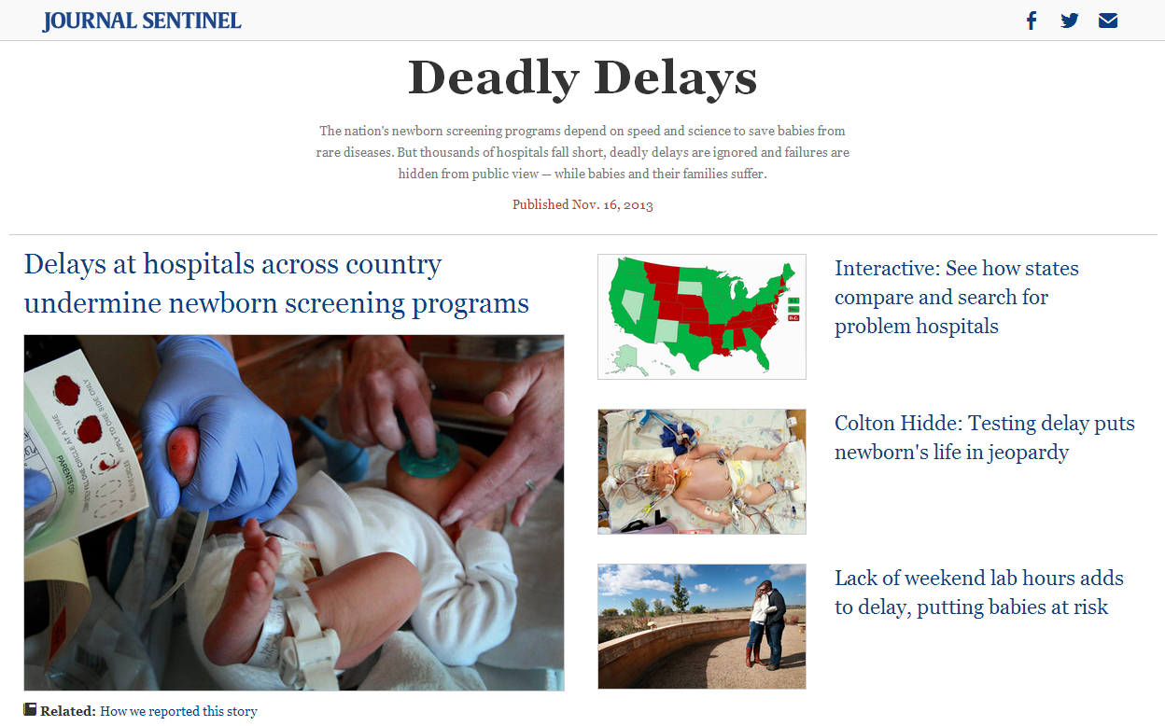
Data: Asked every state for data on all newborn screenings done in 2012 * 31 states provided data
Notes:
ASK YOUR OWN QUESTIONS:
By doing our own data analysis, we aren’t confined by the questions that public officials posed and published in their annual reports or press releases. We can ask questions of the data that haven’t been asked.
This is a very large scale example of that kind of thing, but the idea is a simple one….how often are newborn blood screening samples done within the recommended amount of time to help doctors catch potentially life-threatening conditions in newborn babies?
Since nobody else had asked this question – or even collected all the data – the Milwaukee Journal-Sentinel set out to do it themselves. The resulting story showed that a lot of officials were surprised by the answer; they simply didn’t know the answer because nobody had ever asked the question. This resulted in an amazing story that started having an impact even before it published.
This project was very large and not something every paper can do….but think about this concept of asking a question that has never been asked. You can do that with a lot of things – some being quite simple, others being more demanding like this one.

Slide 23
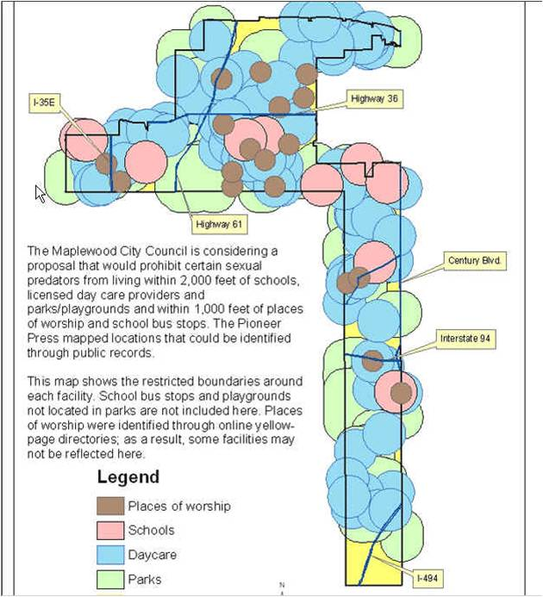

Data: collected either addresses or GIS maps with locations of schools, parks, daycares and places of worship
Notes:
Several years ago, a suburb of St. Paul was considering an ordinance that would’ve prohibited where certain sex offenders could live. The proposal called for banning them from living within 2,000 feet of daycares, schools, parks and playgrounds. And within 1,000 feet of places of worship and bus stops. We used various datasets to find the locations of these places in that city (we didn’t do bus stops or playgrounds) and then used special GIS tools to analyze what portion of the city was left after the restrictions were applied. This map was the result – showing only two small sections of the city unaffected: one was an industrial park in the northern part of the city and the other was under a major interstate highway in the lower part of the city. The following week, the city council tabled the plan and hasn’t brought it back since.

Slide 24

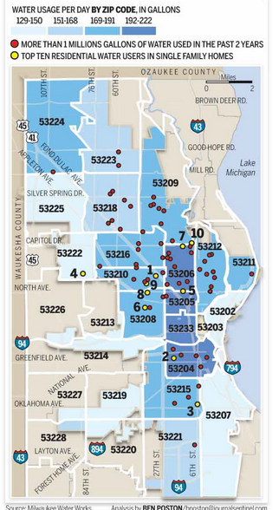
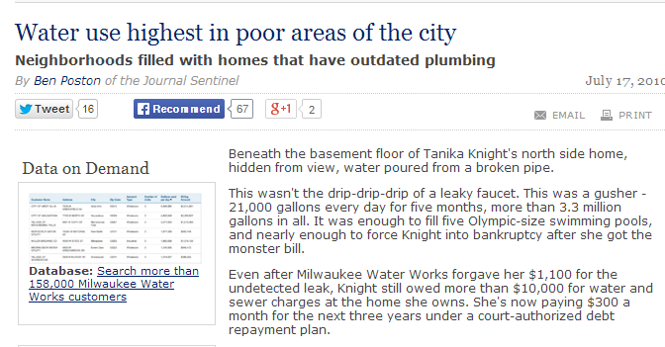
Data: City data on water usage at each address (water billing records)
Notes:
The Milwaukee Journal-Sentinel also asked another interesting question: are there certain parts of the city that use more water than others? (Another way to think of this….are the affluent neighborhoods using a disproportionate share of water because they water their lawns all the time?)
The answer surprised a lot of people: the greatest usage was in the poor areas of the city. Shoe-leather reporting helped them answer why: houses in poor neighborhoods were less likely to have modern toilets, showerheads, etc. that use less water and they were more likely to allow water leaks to go unresolved for longer periods of time.

Slide 25
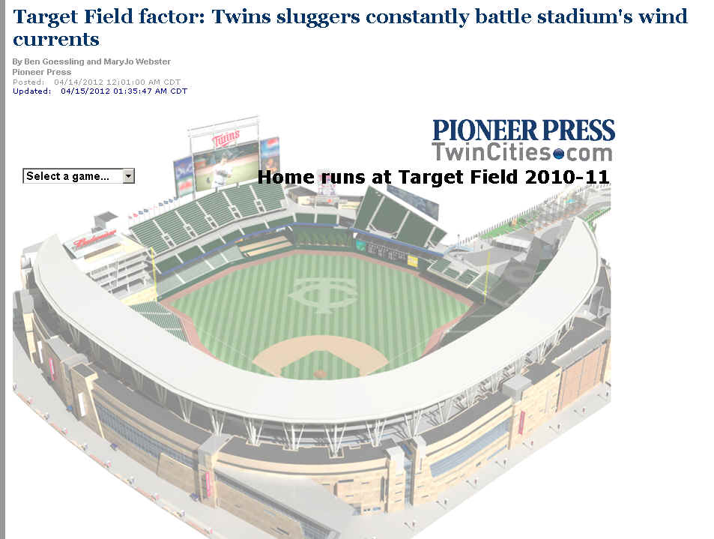
Data:
Hitting data by team for each game
Weather data by day and start time of game
Notes:
IS IT TRUE?
Journalists spend a lot of time writing about whether something is true or not. Most of the time we end up with a lot of “he said she said” -- various people or experts batting around the various opinions or theories.
But sometimes journalists could measure whether something is true or not, using data.
At the Pioneer Press we were getting ready for the third season that the Minnesota Twins baseball team would play in their new stadium, Target Field. The big question everybody was talking about was why the Twins had such a horrible record hitting homeruns those first two seasons. There were tons of theories floating around. But the players all talked about one – the weather.
So the baseball

Slide 26


Better beat reporting

Slide 27
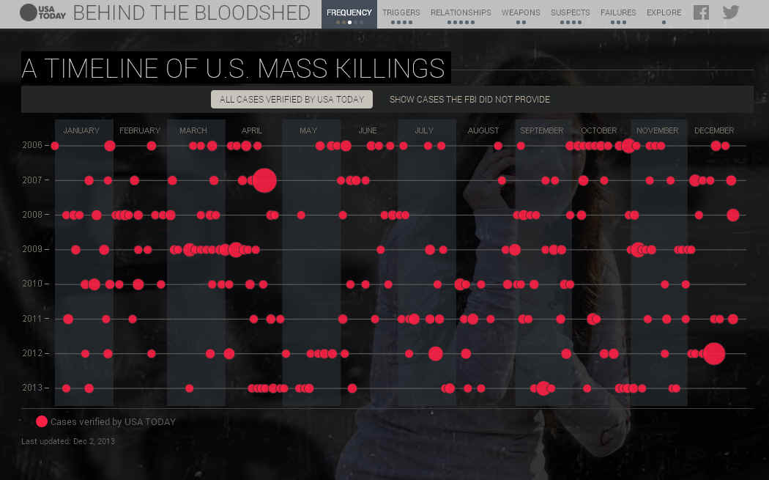

Put big events into context
Data:
FBI data
Media reports
Local police records

Slide 28
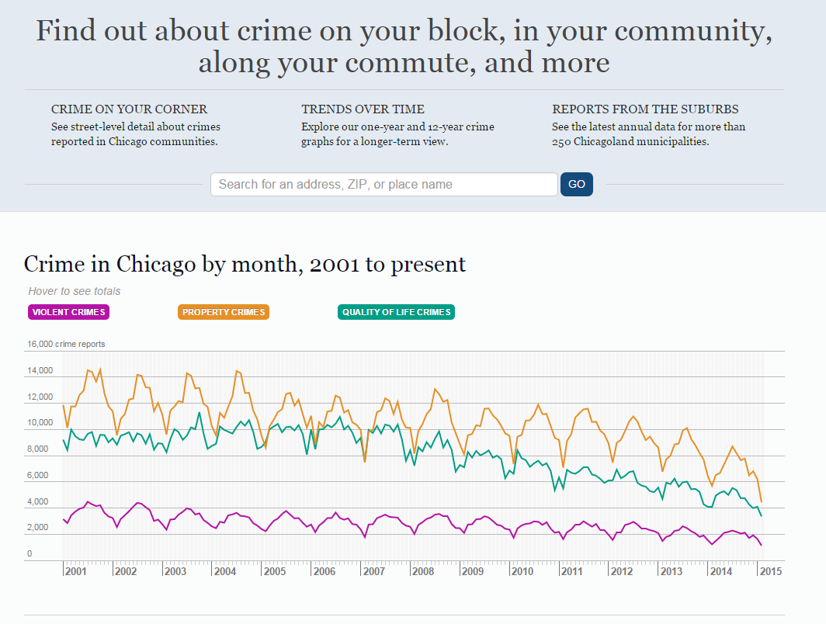
Engage readers
Notes:
You can also use stand-alone data-driven interactives to engage readers. The DFM Data team built crime maps for both St. Paul and Denver. New data flows into these maps on a regular basis, giving readers a great way to keep tabs on crime in their neighborhood. In addition to seeing the overall trends, you can click on a neighborhood and see the actual crimes plotted on the map.

Slide 29
Should we use data analysis?
Has somebody already done this analysis?
How complicated is the analysis?
How important is this story?
How much time do you have?

Slide 30
How long will it take?
Waiting for requested data
Cleaning data, if necessary
Analyzing data
Reporting and repeating analysis

Slide 31
Requesting data
Make sure reporter does some “reporting” or sleuthing about the data before making request. What’s in the data? What’s not?
Don’t ask for “lists” or “reports” – use terms like “machine readable” or “database-friendly format such as Excel or delimited text”
Don’t just ask for a few pieces of information. Think about context.
Notes:
When asking for data, try to think broader than just that one thing you think you want. For example, let’s say you want a dataset listing all the turkey farms in Minnesota and where they are located. That would mean that you’d want, at minimum, a turkey farm name and an address. So what can we do with that? We can map the locations and show where they are geographically. But that’s about it.
But what else does the agency collect about the turkey farms? Does it say how many barns? Does it give a “maximum” number of turkeys it could hold? Does it say anything about the size of the barns? Does it say when the farm was built or first registered with the state? Name of the company that owns it?
If we get some of the other things, we’ve got even more questions we can ask and more flexibility about what we can do with it. We can see which company owns the most farms. Perhaps by using the maximum number of turkeys and the size of the barns we could get some kind of density measurement -- maybe some farms pack their turkeys in more densely than other farms.
The data you want might not exist in the exact FORM that you want. For example, Jeff Meitrodt wanted to find all ag-related deaths in Minnesota. He ask the state if they kept such as list or database. They said no. But then he realized that we have a database of every death in the state, with very detailed fields of information about causes of deaths and occupation of the decedent, even a narrative for some of them. Using the occupation and looking for keywords (like tractor) in the narrative field, he was able to pull together a list of deaths -- it’s possibly a little bit short, but it’s better than nothing.

Slide 32
The data has arrived!
Encourage the reporter to come up with some questions and working theories.
Ask the reporter some questions to get a feel for how well they understand the data. If they can’t answer, encourage them to seek out help from experts or the place the data came from.

Slide 33
Questions you should be asking...
What does each record represent?
What’s the time frame of the data?
Are there any fields you don’t understand?
Does it contain the fields of information you expected?
Does the data need to be “cleaned?”

Slide 34
Analysis
Encourage reporter to keep a data “trail”
Sit down with the reporter, at least once, and have them show you the data and key parts of the analysis
Get digital and graphics people in the loop ASAP
After analysis, have reporter write 2-3 graph summary to help find main points AND the holes
Expect that more analysis will be needed, after additional reporting

Slide 35
The findings
Do the findings make sense?
If something seems too good to be true, it probably is.
Do findings line up with what sources are saying? Do any sources question the results?
Don’t be afraid to consult experts, ask them to review your methodology and findings
Have critics/key sources reviewed the findings? (don’t wait until the last minute!)
Have reporter repeat analysis

Slide 36
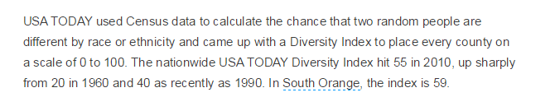
Put “life” in numbers

Slide 37
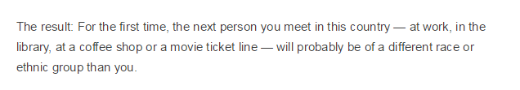

Slide 38
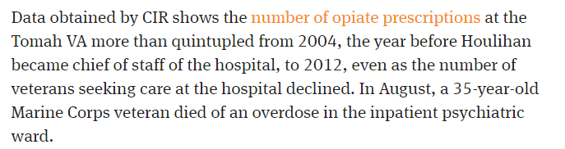
Find a number
Story
Notes:
What’s the key finding? Try to boil that down to language that doesn’t require very many numbers. Note how this story from the Center for Investigative Reporting simply uses “more than quintupled” as it’s star number.

Slide 39
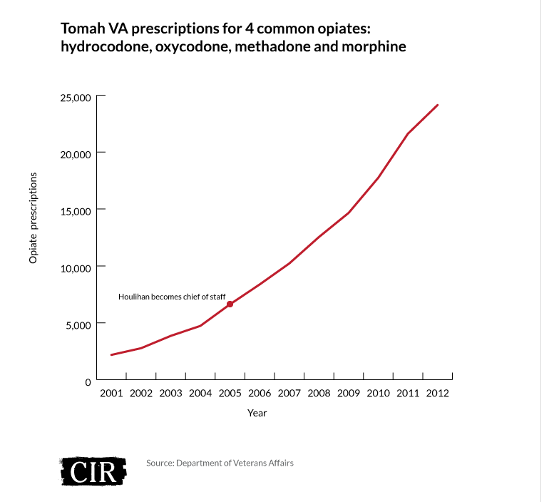
However.....
Notes:
However, look at the graphic that they use to display that quintupling of the number of prescriptions. Remember they noted that this was occurring at the same time as a decline in the number of patients. So wouldn’t it be better to look at the change in the prescriptions per patient ratio?

Slide 40
Other things to consider...
Avoid too many numbers in the text of the story. Characterize!
Give readers context & detail through graphics
Do we have the necessary context? Do we have the “compared to what” answered?
Are we portraying the results honestly and not making too much of it?

Slide 41
Editing
Edit the digital content for usability, clarity, style, spelling/grammar and make sure it complements the story
Do the math!
See bulletproofing guides for more --- mjwebster.github.io/DataJ

Slide 42
Minimum skills for reporters
Data state of mind
Comfortable with spreadsheets (Excel, Google Spreadsheets)
Uses numbers appropriately (rates, adjusting for inflation, etc.)
Able to request database-friendly formatted data via public records laws
Able to pull data out of a PDF (Tabula, CometDocs, ABBY)
Able to make some simple graphics for internal use or possibly online (Excel charts, Google Charts, DataWrapper, Google Fusion Tables)

Slide 43
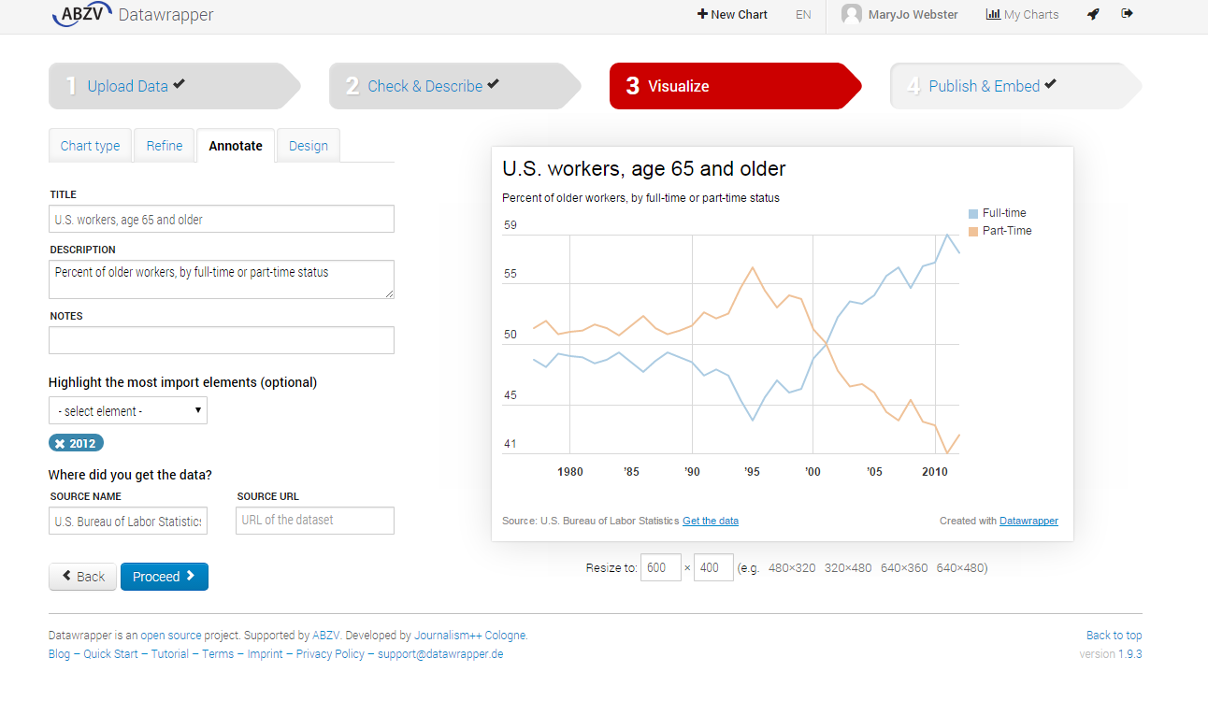

Slide 44
Better....
Proficient and very comfortable with spreadsheets
Able to clean data (OpenRefine)
Make data visualizations or simple interactive maps (Tableau, Google Fusion Tables, CartoDB)

Slide 45
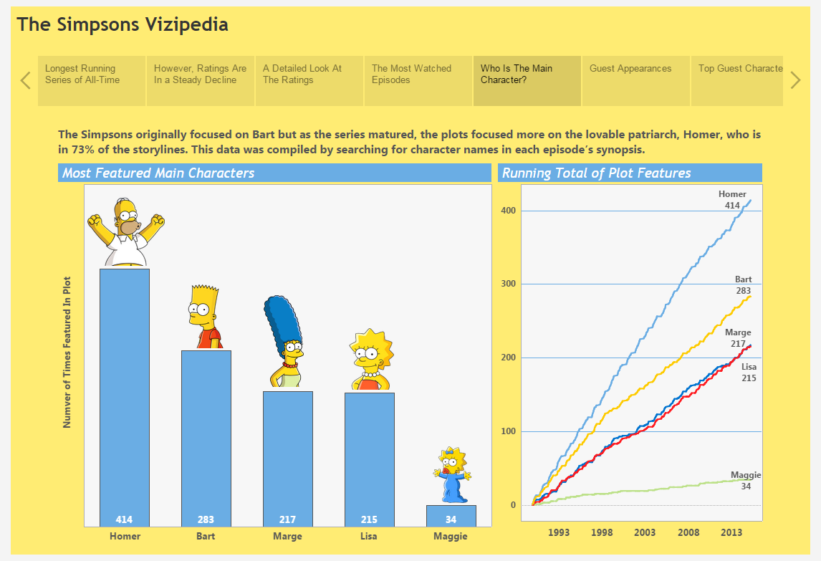
Tableau Public visualization software

Slide 46
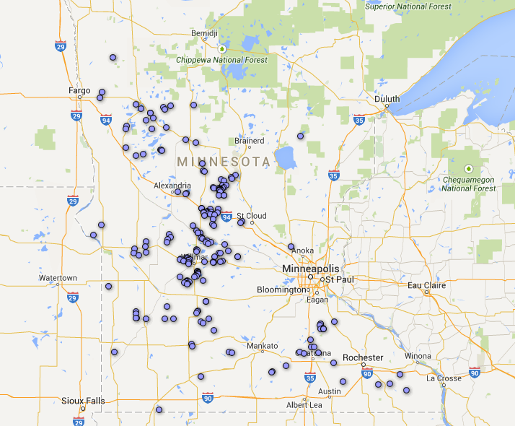
Google Fusion Tables

Slide 47
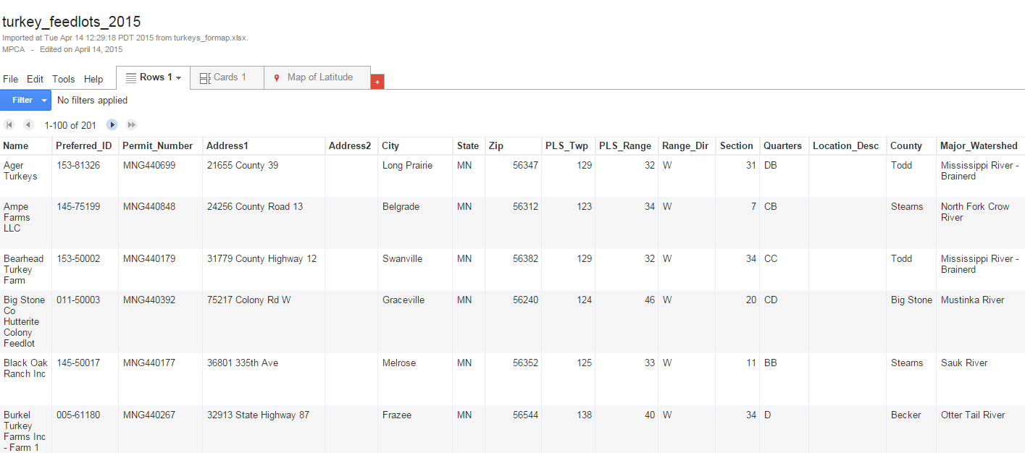

Slide 48
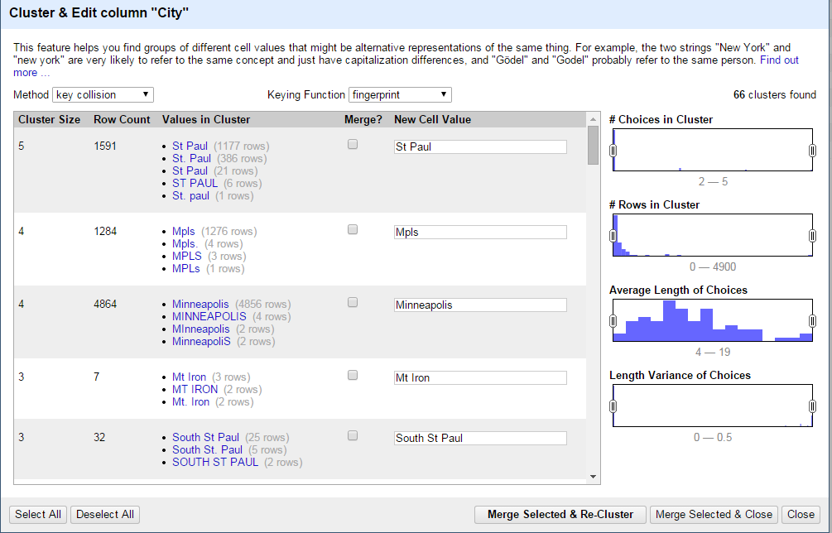
OpenRefine

Slide 49
More advanced...
Analyze data in a database manager (such as Access, SQLite)
Scrape data from a web page (various free tools)
Analyze data using GIS software (ArcGIS or QGIS)

Slide 50
Very advanced...
Able to do statistical analysis, i.e. regression (SPSS or R)
Able to write scripts to clean, scrape or process data (Python or other scripting languages)

Slide 51
Last thoughts....
Read “Data Literacy” book by David Herzog
My training materials: mjwebster.github.io/DataJ

Slide 52
Upcoming/proposed training
SCHEDULED: Data state of mind
SCHEDULED: Using numbers without fear
Best practices for requesting data
Some version of Excel sessions (beginner, refresher, advanced)
Using Tableau to make data visualizations
Using data on a beat
I have a lot of self-guided training materials on other topics, as well.

Slide 53
Tapping newsroom data resources
We don’t have enough bandwidth to do everything!
MaryJo and Jeff Hargarten will work as partners with reporters in producing any data-driven content.
Contact us as early in the process as possible! The day before/of publication is unacceptable unless it’s big breaking news and crucial that we use data.
Notes:
There are a lot of potential ways the Thunderdome Data Team can help your newsroom. The main thing to know is that we’re not always going to be able to help, but we are very eager to try. The best approach is to contact us as early in the process as possible. Contacting Data Team Editor Tom Meagher is the best route to go and he’ll figure out if someone on the team is capable and available to help.
We also are doing a lot of training. Earlier this month, I launched a monthly “community call” where we will offer a variety of data-related topics. Next month we’ll have a virtual demo of a great new data site, CensusReporter.org, that has made census data much more accessible for reporters.
We will be offering other virtual training opportunities in the coming months, and we are also available to come into your newsroom.
And finally, anyone in your newsroom working with data regularly should join our DFM data Google group.

Slide 54
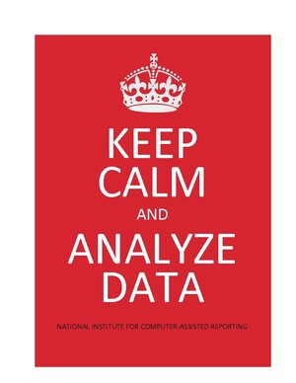
mjwebster.github.io/DataJ

